Slide 1







R Fundamentals Bootcamp
September 2024
You should have R & RStudio installed
https://sites.northwestern.edu/researchcomputing/resources/r-and-rstudio/
We start at 9:35am
Coffee available!
Download the materials from GitHub
https://github.com/nuitrcs/R-fundamentals-summer-workshop
Get help from Northwestern IT Research Computing and Data Services!
Get 1-1 help from us! – bit.ly/rcdsconsult
Bring Your Own Data (BYOD) working groups – bit.ly/byod_groups
Collaborative Project Support – bit.ly/collaborative_project_support

Slide 2
Take a minute to introduce yourself to your neighbors!
Research Computing and Data Services
Instructors:
Emilio Lehoucq
Ritika Giri
Northwestern IT

Slide 3
What to expect this week
Please be ready to start at 9:30am. We have a lot to cover! ⏰
9:30am – 12pm: morning session
12pm – 1pm: lunch and nap!
1pm – 3:30pm: afternoon session
Breaks in between
We have coffee! Feel free to refill your cup as needed ☕️
Come talk to us during breaks or before and after sessions!
We love chatting and are here to help you with your research 🙂

Slide 4
Sticky Notes
I'm done/
doing OK
I need help/
I'm stuck

Slide 5
What are we doing today?
Learning concepts that you need for R
(some of which also apply to other programming languages)
1
Getting to know R and RStudio
2

Slide 6
R / RStudio
File paths
Working directory
R scripts and Documents
Functions
Variables
Packages
Importing data
Data frames
Indexing data frames and vectors
Subsetting data
Missing values
No worries if you don't understand any of these terms yet!!
Notes:
Some concepts we will be learning today

Slide 7

Who are you?
Done any coding before?
Majored in?
Love cats?
Feeling apprehensive?
Feeling confident?
Used R before?

Slide 8


ASK QUESTIONS!
ASK FOR a USE-CASE
Don't worry—we're all learning!
We're going to cover a lot. Learning to program takes time and can be hard at first.
It's okay if you don't understand or remember everything. As you code, you'll get better and more comfortable.
Try to have fun during this workshop and don't be afraid to play around with code!

Slide 9

Think before coding!
During the exercises, you'll have the inclination to start coding immediately... but wait!
Before coding, think about the problem and...
Define the task that you're trying to accomplish
Identify the input and the output
Break the task into subtasks
Order the subtasks logically
You can even use a good, old piece of paper!

Slide 10

Help!
Help!
Every programmer needs help. As you code, these will be your best friends:
Documentation
Stackoverflow.com
Github.com
Google
LLMs (Microsoft Bing/Copilot, ChatGPT, Google Gemini)
Your colleagues
Our free consult service: bit.ly/rcdsconsult

Slide 11
Double click on the .RProj file to open the project in RStudio
Let’s start !

Slide 12
Concepts we will cover today
Terminology
Data Types
Variables
Vectors/Lists
Functions
File systems
Data Frames
Notes:
Some concepts we will be learning today

Slide 13
Concepts we will cover today
Terminology
Data Types
Variables
Vectors/Lists
Functions
File systems
Data Frames
Notes:
Some concepts we will be learning today

Slide 14
terminology
Programming languages
consoles
guis

Slide 15
GUI
GUI: Graphical User Interface: Programs on your computer with buttons and other visual elements; you can interact with a mouse or touchscreen
PowerPoint, Word, Excel, SPSS, Zoom, web browser, etc.
Notes:
They can be used for analysis – but suffer from a big problem!

Slide 16

Problem: How do we tell others what we did? How do we keep track of what we did for ourselves?

Slide 17
Programming Languages
A system for giving instructions to a computer (writing code)
Specific words and characters in a specific order

Slide 18
Console
Console: Simple computer program where we type commands, one line at a time (hence: command line)
They can run different “languages”: bash, zsh, PowerShell (Windows), R, Python
Launching R runs the R console
Type instructions at a prompt (>)
Used for basic operations and running other programs

Slide 19
Console/Terminal/Shell/Command Line Interface
MacOS Applications > Terminal
Windows Command Prompt (Start > cmd) or Powershell
RStudio “Terminal” tab (we will see this later)
R Console (language specific)
Language specific consoles (similar to R)

Slide 20

Let’s open the TerminaL…
Notes:
Open the terminal, explain basic concepts
2 + 2
Did not work
Open r with “r”
Now 2+2 works
Same thing as opening R – directly
Open R and show this

Slide 21
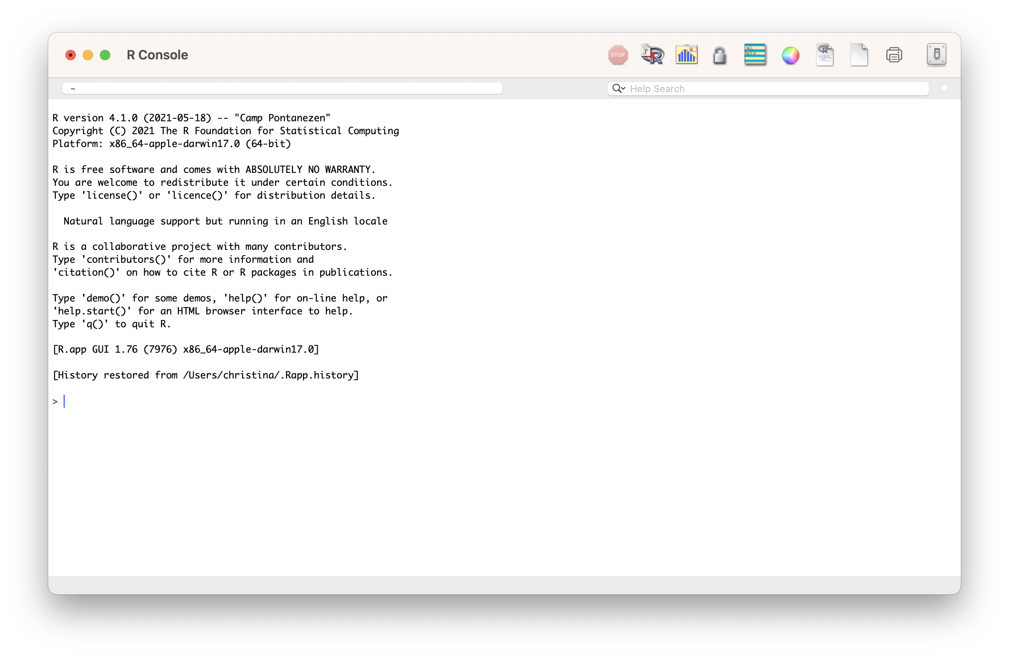
THE R Console
Notes:
Show a few math commands on the R console to show what it’s doing:
2 + 2

Slide 22

But that’s sometimes annoying and inconvenient… and how do we record what we did?

Slide 23
IDE
An IDE makes it easy and convenient to write code!
IDE: Integrated Development Environment (e.g., RStudio): A GUI that helps make writing computer programs easier and interfaces with an interpreter or compiler
Usually includes:
File explorer
Area for writing code/scripts
Console for running interpreted languages
General terminal window for your system
Notes:
Interpreter or compiler – explain this briefly

Slide 24
IDe
An IDE makes it easier and more convenient to write code!
IDE: Integrated Development Environment (e.g., RStudio): A GUI that helps make writing computer programs easier and interfaces with an interpreter or compiler
Usually includes:
File explorer
Area for writing code/scripts
Console for running interpreted languages
General terminal window for your system
Convert human-readable code into machine-readable instructions
Notes:
“The Compiler and Interpreter, both have similar works to perform. Interpreters and Compilers convert the Source Code (HLL) to Machine Code (understandable by Computer). In general, computer programs exist in High-Level Language that a human being can easily understand. But computers cannot understand the same high-level language, so for computers, we have to convert them into machine language and make them readable.” -- https://www.geeksforgeeks.org/difference-between-compiler-and-interpreter/

Slide 25

R vs RStuDio

Slide 26
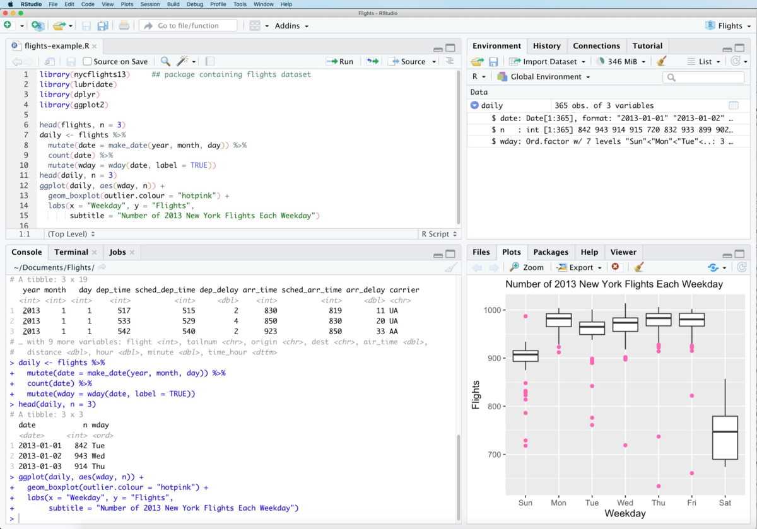
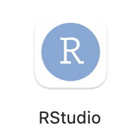
R vs RStuDio

Slide 27
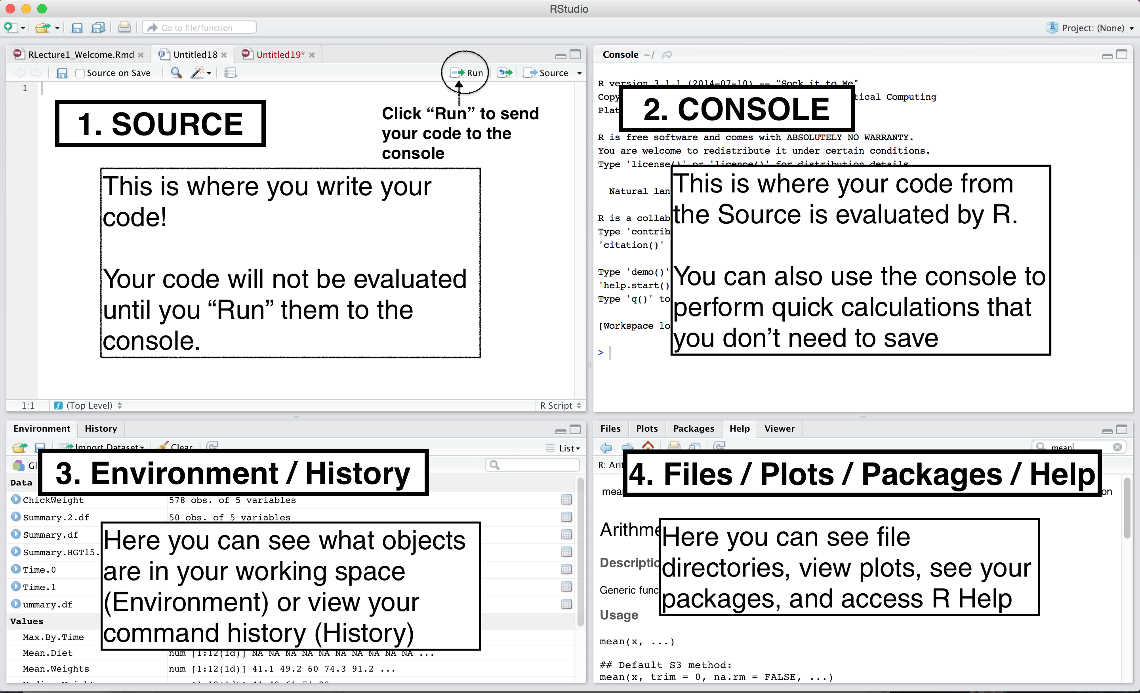
Rstudio pane layout
Notes:
Just a layout – describe in demo on next slide

Slide 28
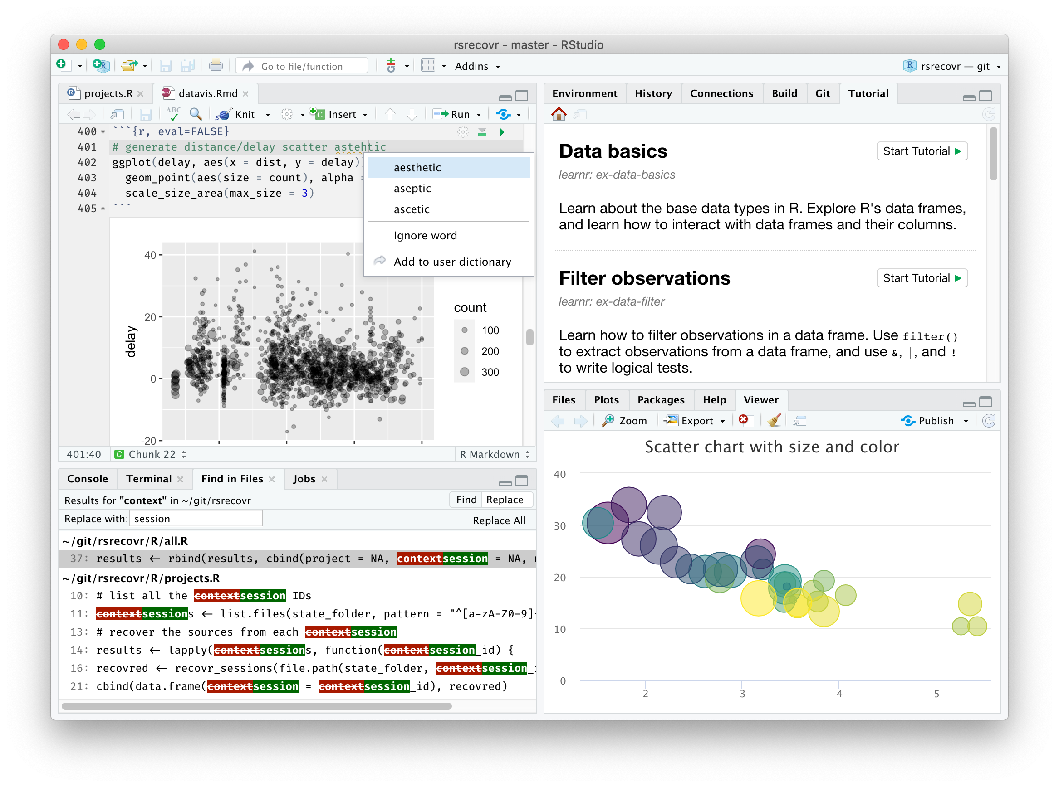
Let’s open RSTUDIO

Slide 29

Your Quest: Should you choose to accept!
Quest 1.
Type some math equations in the console and get answers
> Press enter at the end of a line to run the command
Quest 2.
Open the file script1.R in Rstudio.
You may do so by following either path:
(1) File menu > Open File…
(2) Go to the File Panel in Rstudio, click on the File tab and then click on the file to open it

Slide 30

Everything that is an R command still has to run through the R interpreter (in the R console in RStudio)
Some buttons and menus write code for us!

Slide 31

YAY!
We can keep a full record of everything we do!
Don’t have to write down instructions like:
open this menu, pick this option, check the third button, etc.
where the steps might vary with software version, operating system, etc..

Slide 32


YAY!
We can keep a full record of everything we do!
Don’t have to write down instructions like:
open this menu, pick this option, check the third button, etc.
where the steps might vary with software version, operating system, etc..
Means we can do reproducible science and research
Does not mean that this happens automatically!

Slide 33
Quiz Time!
Which of these are true?
A: RStudio is a programming language
B: R and RStudio are the same program
C: RStudio is an IDE
D: RStudio is a GUI
E: R automatically makes our code reproducible
F: All R commands have to run through the R console

Slide 34
Concepts we will cover today
Terminology
Data Types
Variables
Vectors/Lists
Functions
File systems
Data Frames
Notes:
Some concepts we will be learning today

Slide 35
Data types & Boolean operators
Head back to RStudio...script2.R
Strings, numerics
true false
conditional expressions

Slide 36
Quiz Time!
Which of these are true?
A: "\n" is an empty string
B: (TRUE & FALSE) | (FALSE | TRUE)
C: TRUE == 1
D: “Dog” == “dog”
E: "this is a valid character data'
F: The value false can be represented as: FALSE, F, or false

Slide 37
Concepts we will cover today
Terminology
Data Types
Variables
Vectors/Lists
Functions
File systems
Data Frames
Notes:
Some concepts we will be learning today

Slide 38
variables
Assigning values
Storing values
Variable names

Slide 39

Variables
A variable can store any value you assign to it.. (just like variables in algebra)
3

Slide 40
Variables
A variable can store any value you assign to it..
“dog”

Slide 41
Variables
A variable can store any value you assign to it..
TRUE

Slide 42
Variables
Every variable has a name
x

Slide 43
Variables
x
You can retrieve the value stored in the variable by calling it by its name
TRUE

Slide 44
Variables
Assigning values to variables
x = 3
x <- 3
Variable name
"Left hand side"
Value
"Right hand side"
Assignment
operator

Slide 45
Variables
x <- 3
<- is preferred in R

Slide 46
Variables
x <- 3 + 5
x
x is 8

Slide 47
Variables
x <- 3
x + 5
x
x is 3

Slide 48
Variables
x <- 3
x <- x + 5
x
x is 8

Slide 49
Variables
x <- 3
y <- 5
x <- x + y
x
x is 8

Slide 50
Variables
x <- 3
y <- 5
x <- x + y
y <- 7
x
x is 8

Slide 51
Concepts we will cover today
Terminology
Data Types
Variables
Vectors/Lists
Functions
File systems
Data Frames
Notes:
Some concepts we will be learning today

Slide 52
Vectors lists
Storing multiple values
Indexing

Slide 53
Storing Multiple Values Together
We combine them with c() into a vector
x <- c(2, 4, 7, 8)
In R, a vector is a list of items of the same data-type.
Vectors may be called arrays in other languages.

Slide 54
Assigning a vector as a value to variable x
c(2, 4, 7, 8)
x

Slide 55
Indexing Values in a Vector
Retrieving single elements from a vector
Indexing –giving a unique number to each element based on its position in the list
Indices in R start from 1
Position/Index: 1 2 3 4
x <- c(2, 4, 7, 8)

Slide 56
Selecting elements from a vector
elements of a vector can be selected using [ ]
The position/index goes inside [ ]
x <- c(2, 4, 7, 8)
x[1] stores 2
x[2] stores 4

Slide 57
changing a variable
x <- c(2, 4, 7, 8)
x[2] <- 6
x
2, 6, 7, 8

Slide 58
Changing a variable
x <- c(2, 4, 7, 8)
x <- 6
x
6
R doesn’t care what’s in the variable “box”!

Slide 59

Back to RStudio…
Open script3.R

Slide 60
Concepts we will cover today
Terminology
Data Types
Variables
Vectors/Lists
Functions
File systems
Data Frames
Notes:
Some concepts we will be learning today

Slide 61
functions
define a function
call a function
Input parameters
return values

Slide 62
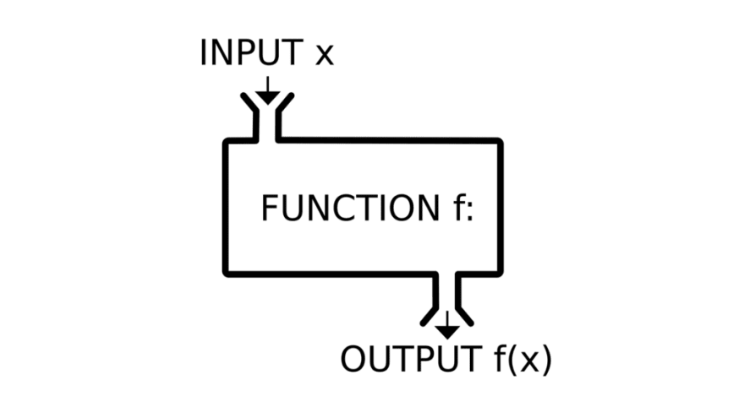
Functions in programming ~ similar to math functions
f(x) = y
Takes input values, also called parameters or arguments
Returns an output value, also called a return value
R functions usually don't alter their input values (but they sometimes do!)

Slide 63
Why should you use functions?
Pieces of code designed to perform specific tasks
You can re-use them multiple times without re-writing the same code
They help you organize your code into manageable chunks
You can use them just knowing their input and output
→ They help you write code that is clearer and less error prone. They also help you conserve your valuable brain power

Slide 64
Let’s look at a useful function..
read.csv(file, header = TRUE, sep = ",", quote = "\"",
dec = ".", fill = TRUE, comment.char = "", ...)

Slide 65
Defining functions
Functions have names
read.csv(file, header = TRUE, sep = ",", quote = "\"",
dec = ".", fill = TRUE, comment.char = "", ...)

Slide 66
Defining functions
Functions can be called with their names using ( )
read.csv(file, header = TRUE, sep = ",", quote = "\"",
dec = ".", fill = TRUE, comment.char = "", ...)

Slide 67
Defining functions
Functions take input parameters or arguments inside ( )
read.csv(file, header = TRUE, sep = ",", quote = "\"",
dec = ".", fill = TRUE, comment.char = "", ...)

Slide 68
Defining functions
Function parameters also have names (parameter names)
read.csv(file, header = TRUE, sep = ",", quote = "\"",
dec = ".", fill = TRUE, comment.char = "", ...)

Slide 69
Defining functions
Some function parameters have default values
read.csv(file, header = TRUE, sep = ",", quote = "\"",
dec = ".", fill = TRUE, comment.char = "", ...)
These are the values the function parameter will take if no values are provided for it by the user

Slide 70
Defining functions
However, some parameters are required parameters!
read.csv(file, header = TRUE, sep = ",", quote = "\"",
dec = ".", fill = TRUE, comment.char = "", ...)
These parameter values need to be provided by the user

Slide 71
Defining functions
Some functions also have additional undefined parameters
read.csv(file, header = TRUE, sep = ",", quote = "\"",
dec = ".", fill = TRUE, comment.char = "", ...)
These are additional values that can be taken by this function but are not explicitly listed in the function definition.
We will see some examples later.

Slide 72
Defining functions
Putting it all together
read.csv(file, header = TRUE, sep = ",", quote = "\"",
dec = ".", fill = TRUE, comment.char = "", ...)
Functions have names, they can be called with ().
Functions take input parameters, which also have parameter names.
Some parameters are required, some have default values, and some others are additional (hidden) parameters.

Slide 73
Calling functions
Functions are called as: function_name(input parameters/args)

Slide 74

Calling functions
Functions are called as: function_name(input parameters/args)
How does R know which value to assign to which input parameter??

Slide 75

Calling functions
Functions are called as: function_name(input parameters/args)
How does R know which value to assign to which input parameter??
by name
by position
by name and position

Slide 76
Calling functions
Defining parameter values by Name
read.csv(file, header = TRUE, sep = ",", quote = "\"",
dec = ".", fill = TRUE, comment.char = "", ...)
read.csv(file=“results.txt”,
header=TRUE,
sep=“\t”)

Slide 77

Calling functions
Defining parameter values by Name
read.csv(file, header = TRUE, sep = ",", quote = "\"",
dec = ".", fill = TRUE, comment.char = "", ...)
read.csv( sep=“\t”,
file=“results.txt”,
header=TRUE)

Slide 78
Calling functions
Defining parameter values by Position
read.csv(file, header = TRUE, sep = ",", quote = "\"",
dec = ".", fill = TRUE, comment.char = "", ...)
read.csv(“results.txt”, TRUE, “\t”)

Slide 79
Calling functions
Defining parameter values by Position
read.csv(file, header = TRUE, sep = ",", quote = "\"",
dec = ".", fill = TRUE, comment.char = "", ...)
1, 2, 3
read.csv(“results.txt”, TRUE, “\t”)

Slide 80
Calling functions
Defining parameter values by Position & Name
read.csv(file, header = TRUE, sep = ",", quote = "\"",
dec = ".", fill = TRUE, comment.char = "", ...)
read.csv(file=“results.txt”, TRUE, “\t”)

Slide 81
Calling functions
Defining parameter values by Position & Name
read.csv(file, header = TRUE, sep = ",", quote = "\"",
dec = ".", fill = TRUE, comment.char = "", ...)
read.csv(file=“results.txt”, TRUE, “\t”)
Match all named arguments first,

Slide 82
Calling functions
Defining parameter values by Position & Name
read.csv(file, header = TRUE, sep = ",", quote = "\"",
dec = ".", fill = TRUE, comment.char = "", ...)
read.csv(file=“results.txt”, TRUE, “\t”)
Match all named arguments first,
Match positions in order – 1

Slide 83
Calling functions
Defining parameter values by Position & Name
read.csv(file, header = TRUE, sep = ",", quote = "\"",
dec = ".", fill = TRUE, comment.char = "", ...)
read.csv(file=“results.txt”, TRUE, “\t”)
Match all named arguments first,
Match positions in order – 1
Match positions in order – 2

Slide 84
Calling functions
Defining parameter values by Position & Name
read.csv(file, header = TRUE, sep = ",", quote = "\"",
dec = ".", fill = TRUE, comment.char = "", ...)
read.csv(header=TRUE, “results.txt”, “\t”)
Let’s try another example..

Slide 85
Calling functions
Defining parameter values by Position & Name
read.csv(file, header = TRUE, sep = ",", quote = "\"",
dec = ".", fill = TRUE, comment.char = "", ...)
read.csv(header=TRUE, “results.txt”, “\t”)
Named arguments matched!

Slide 86
Calling functions
Defining parameter values by Position & Name
read.csv(file, header = TRUE, sep = ",", quote = "\"",
dec = ".", fill = TRUE, comment.char = "", ...)
read.csv(header=TRUE, “results.txt”, “\t”)
Named arguments matched!
Position 1 matched to first leftover argument

Slide 87
Calling functions
Defining parameter values by Position & Name
read.csv(file, header = TRUE, sep = ",", quote = "\"",
dec = ".", fill = TRUE, comment.char = "", ...)
read.csv(header=TRUE, “results.txt”, “\t”)
Named arguments matched!
Position 1 matched to first leftover argument
Position 2 matched to second leftover argument

Slide 88
Quiz Time!
Will this function call work?
read.csv(file, header = TRUE, sep = ",", quote = "\"",
dec = ".", fill = TRUE, comment.char = "", ...)
read.csv("results.txt", sep="\t")
read.csv("results.txt", "\t")
read.csv("results.txt", TRUE, "\t")

Slide 89
Quiz Time!
Will this function call work?
read.csv(file, header = TRUE, sep = ",", quote = "\"",
dec = ".", fill = TRUE, comment.char = "", ...)
read.csv("results.txt", sep="\t")

Slide 90

Quiz Time!
Will this function call work?
read.csv(file, header = TRUE, sep = ",", quote = "\"",
dec = ".", fill = TRUE, comment.char = "", ...)
read.csv("results.txt", sep="\t")
Named argument sep is matched with value “\t”
First value “results.txt” is matched to first argument file

Slide 91
Quiz Time!
Will this function call work?
read.csv(file, header = TRUE, sep = ",", quote = "\"",
dec = ".", fill = TRUE, comment.char = "", ...)
read.csv("results.txt", "\t")

Slide 92

Quiz Time!
Will this function call work?
read.csv(file, header = TRUE, sep = ",", quote = "\"",
dec = ".", fill = TRUE, comment.char = "", ...)
read.csv("results.txt", "\t")
There are no named arguments
First value “results.txt” is matched to first argument file
Second value “\t” is matched to second argument header

Slide 93
Quiz Time!
Will this function call work?
read.csv(file, header = TRUE, sep = ",", quote = "\"",
dec = ".", fill = TRUE, comment.char = "", ...)
read.csv("results.txt", TRUE, "\t")

Slide 94
Quiz Time!
Will this function call work?
read.csv(file, header = TRUE, sep = ",", quote = "\"",
dec = ".", fill = TRUE, comment.char = "", ...)
read.csv("results.txt", TRUE, "\t")
There are no named arguments
First value “results.txt” is matched to first argument file
Second value TRUE is matched to second argument header
Third value “\t” is matched to third argument sep

Slide 95
Returning values
The output of a function is its return value
Function call
Return value
abs(-3)
3
But this output value is not saved!
How do we save this value??
We can save it by assigning the return value to a variable!
x <- abs(-3)

Slide 96
Returning values
What happens when there is no return value?
Function call
Return value
print(x)
3
Why did this happen?
If no return value is specified, then
by default, a function returns the value of the last expression evaluated

Slide 97
Calling functions with variable arguments
Why did this function call work?
Function call
print(x)
3
x
Evaluated as
print(3)

Slide 98
Calling functions with variables as arguments
What happens if I change x?
Change x
x <- “hello”
“hello”
x
Function call
print(x)
Can you think of a scenario for read.csv() where a variable as argument might be useful??
Evaluates as
“hello”

Slide 99
Back to RStudio…
Open script4.R

Slide 100
Concepts we will cover today
Terminology
Data Types
Variables
Vectors/Lists
Functions
File systems
Data Frames
Notes:
Some concepts we will be learning today

Slide 101
File systems
Absolute paths
Relative paths
Working directory

Slide 102
File paths
How do we tell R where our files are without using point and click interfaces?
Every file has an absolute path, which starts with the root
An absolute path makes no assumptions about your current location. It starts from the start of your hard drive and describes every step to get to a file. The root is that start—it's the starting point to organize all files on your computer

Slide 103
PC (Windows)
c:

Slide 104

C:\
PC (Windows)
c:
Program Files
Users
System

Slide 105
C:\Users\
PC (Windows)
c:
Program Files
Users
System
ritika
guest

Slide 106
C:\Users\ritika\
PC (Windows)
c:
Program Files
Users
System
ritika
guest
Documents
Desktop
Music
Photos

Slide 107
C:\Users\ritika\Documents\
PC (Windows)
c:
Program Files
Users
System
ritika
guest
Documents
Desktop
Music
Photos
dissertation
my_project

Slide 108

C:\Users\ritika\Documents\my_project
PC (Windows)
c:
Program Files
Users
System
ritika
guest
Documents
Desktop
Music
Photos
dissertation
my_project
data.csv
process.py
DRAFT.docx

Slide 109
C:\Users\ritika\Documents\my_project\data.csv
PC (Windows)
c:
Program Files
Users
System
ritika
guest
Documents
Desktop
Music
Photos
dissertation
my_project
data.csv
process.py
DRAFT.docx

Slide 110
/Users/ritika/Documents/my_project/data.csv
MacOS
/
Applications
Users
System
ritika
guest
Documents
Desktop
Music
Photos
dissertation
my_project
data.csv
process.py
DRAFT.docx

Slide 111
Absolute Paths
C:\Users\ritika\Documents\my_project\data.csv
/Users/ritika/Documents/my_project/data.csv

Slide 112
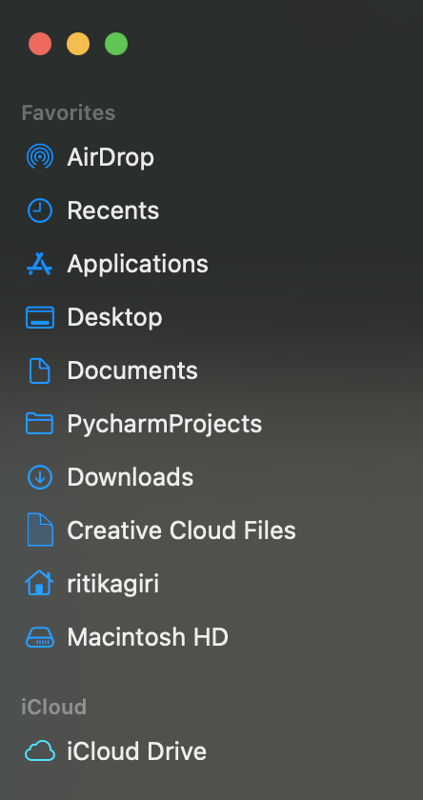
Home Directory
The home directory is a personal directory assigned to a user.
The root directory is the starting point of the whole computer, while the home directory is specific to a user.

Slide 113
Home Directory: C:\Users\ritika = ~
c:
Program Files
~
Users
System
ritika
guest
Documents
Desktop
Music
Photos
dissertation
my_project
data.csv
process.py
DRAFT.docx

Slide 114
~/Documents/my_project/data.csv
c:
Program Files
Users
System
ritika
guest
Documents
Desktop
Music
Photos
dissertation
my_project
data.csv
process.py
DRAFT.docx

Slide 115
Working Directory
A directory in the file system associated with a running process or program (aka "where you're working from")
>> Where the computer starts when looking for files
>> Uses Relative File Paths

Slide 116
Relative Path from Documents: my_project/data.csv
c:
Program Files
Users
System
ritika
guest
Documents
Desktop
Music
Photos
dissertation
my_project
data.csv
process.py
DRAFT.docx

Slide 117
From ritika:
c:
Program Files
Users
System
ritika
guest
Documents
Desktop
Music
Photos
dissertation
my_project
data.csv
process.py
DRAFT.docx
Notes:
Documents/my_project/data.csv

Slide 118
From ritika: Documents/my_project/data.csv
c:
Program Files
Users
System
ritika
guest
Documents
Desktop
Music
Photos
dissertation
my_project
data.csv
process.py
DRAFT.docx
Notes:
Documents/my_project/data.csv

Slide 119
.. means go up a level

Slide 120
From Desktop: ../Documents/my_project/data.csv
c:
Program Files
Users
System
ritika
guest
Documents
Desktop
Music
Photos
dissertation
my_project
data.csv
process.py
DRAFT.docx
Notes:
Documents/my_project/data.csv

Slide 121
From dissertation: ../Documents/my_project/data.csv
c:
Program Files
Users
System
ritika
guest
Documents
Desktop
Music
Photos
dissertation
my_project
data.csv
process.py
DRAFT.docx
Notes:
Documents/my_project/data.csv

Slide 122
From dissertation: ../my_project/data.csv
c:
Program Files
Users
System
ritika
guest
Documents
Desktop
Music
Photos
dissertation
my_project
data.csv
process.py
DRAFT.docx
Notes:
Documents/my_project/data.csv

Slide 123
How to find paths in your computer?
Mac:
Right click on a file > Get info ("Where")
Windows:
Right click on a file > Properties ("Location")
Or clicking in the box that contains the file name (above the list of files inside the folder)

Slide 124
But what is the Working Directory for R?
Default: home directory of the user (~)
RStudio Projects: the folder you associate with the project
>> You can set or change the working directory
Let’s go to R for a minute to see how to do this…

Slide 125
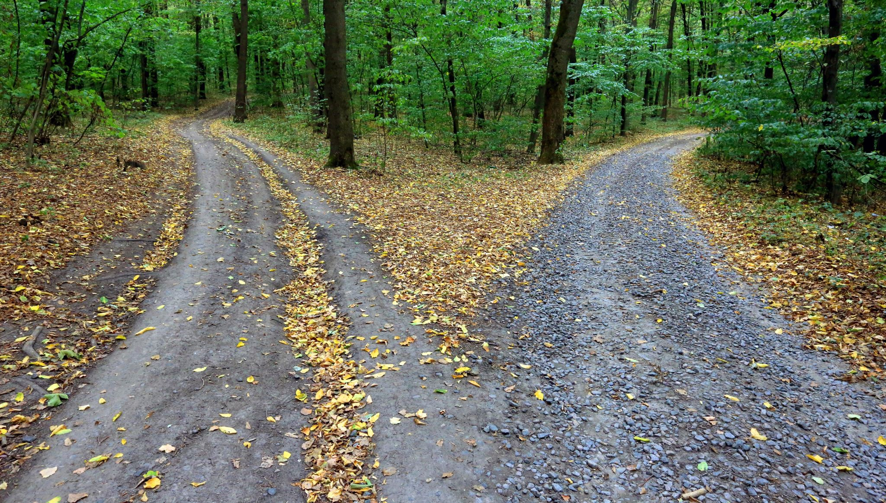
Why not just use absolute paths?

Slide 126
Store Project Files Together
project_directory
code
process_data.r
make_graphs.r
estimate_model.r
data
people.csv
exam1.csv
output
impact_plot.pdf
reports
chapter1.docx
working directory

Slide 127
Back to RStudio…
Open script5.R

Slide 128
Working with files
Reading, opening
Writing, saving

Slide 129
Plain Text Files
NO FORMATTING
NO IMAGES
Common extensions: .txt, .tab, .csv
Also plain text:
Data files: XML, JSON
Markup: HTML, Markdown (.md), LaTeX (.tex)
Code: R scripts (.r), Python scripts (.py)
Notes:
But it's not about the extension -- extension doesn't determine if a file is plain text

Slide 130
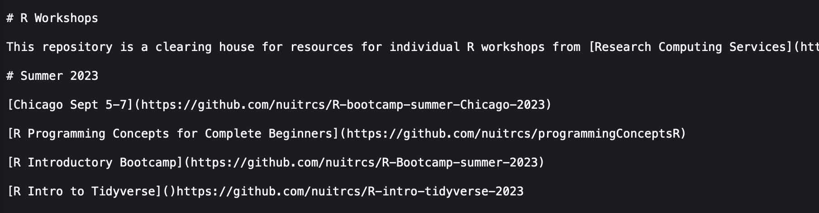
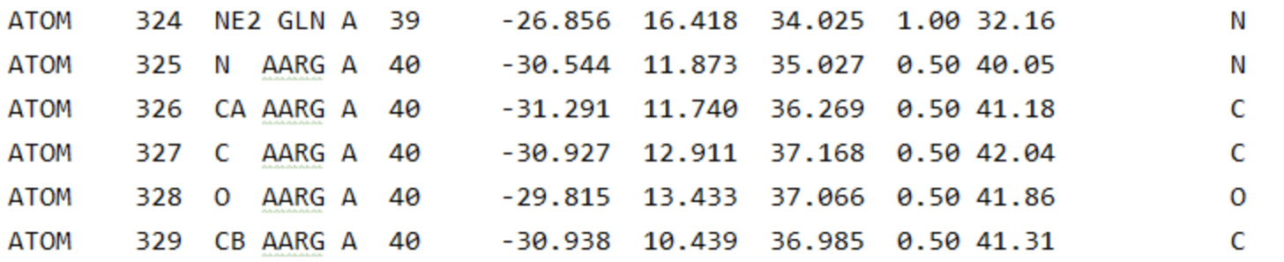
Plain Text Files
https://raw.githubusercontent.com/nuitrcs/rworkshops/master/README.md
File: molecule.pdb

Slide 131
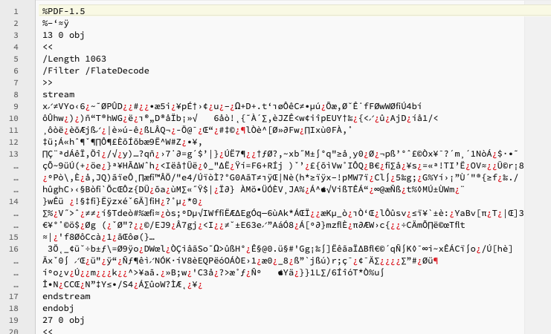
Not a Plain Text File

Slide 132
Plain Text Editors
RStudio lets you write (or open) plain text files (so do other IDEs)
Stand alone options:
Mac: BBEdit
Windows: Notepad ++
Either: Sublime Text
Usually avoid built-in options: Notepad, TextEdit, WordPad

Slide 133
Plain Text Editors
RStudio lets you work with plain text files.
Popular file formats used by researchers and R coders:
R script (.R)
R Markdown (.Rmd)
Quarto Markdown (.qmd)

Slide 134

R Markdown/QuaRTo
Back to RStudio...

Slide 135
Concepts we will cover today
Terminology
Data Types
Variables
Vectors/Lists
Functions
File systems
Data Frames
Notes:
Some concepts we will be learning today

Slide 136
Data frames
Rectangles of data
Rows
Columns
indexing

Slide 137

Rectangles of Data
View(data)
variables/
features
observations
values

Slide 138
Rows: Observations
nrow(data)
Person (or mouse, worm, etc.)
Country
Year
Run/trial of an experiment
Chemical
Sample

Slide 139
Columns: Variables
ncol(data)
Measurements
Grouping/identification variables:
> trial/sample
> condition
> label for the observation (country name)
Each ID variable in its own column

Slide 140
The $ operator
Access columns by names as:
data$column

Slide 141
Indexing
Access rows or columns by indexing as:
data [ rows , columns ]

Slide 142
Indexing : by POSITION
Provide the positions of the rows/cols you want:
data [ 1:10 , 2:5 ]
data [ , 2:5 ]
data [ 1:10 , ]
data [c(1,4) , c(3,5)]

Slide 143
Indexing : by POSITION
Provide the positions of the rows/cols you don’t want:
data [-1:-10, ]

Slide 144
Indexing : by NAME
Provide the names of the columns you want:
data [ , ”school” ]
data [ , c(”school”, “year”) ]

Slide 145
Indexing : by CONDITION
Filter rows by the conditions you want:
data[data$column == value, ]

Slide 146
Indexing : by CONDITION
Filter rows by the conditions you want:
data[data$column == value, ]
data[data$column > value, ]
data[data$column < value, ]

Slide 147
Indexing : by multiple CONDITIONs
Filter rows by combining conditions you want:
AND:
data[data$col1 >= x & data$col2 >= y , ]
OR:
data[data$col1 >= x | data$col2 >= y , ]

Slide 148
Missing values NA
Missing values are represented by a special value NA
is.na(x) – returns TRUE or FALSE
For example:
data[is.na(data$column), ]

Slide 149
Back to RStudio…
Open script6.R

Slide 150
Concepts we covered today
Terminology
Data Types
Variables
Vectors/Lists
Functions
File systems
Data Frames
Notes:
Some concepts we will be learning today

Slide 151
workflow
Organize code projects

Slide 152
Using R packages
R packages are extensions to the R statistical programming language.
R packages contain code, data, and documentation in a standardised collection format that can be installed by users of R, typically via a centralised software repository such as CRAN
Examples of useful packages:
haven (Enables R to read and write data from SAS, SPSS, and Stata)
ggplot2 (R's famous package for making beautiful graphics)
survival (Tools for survival analysis)

Slide 153
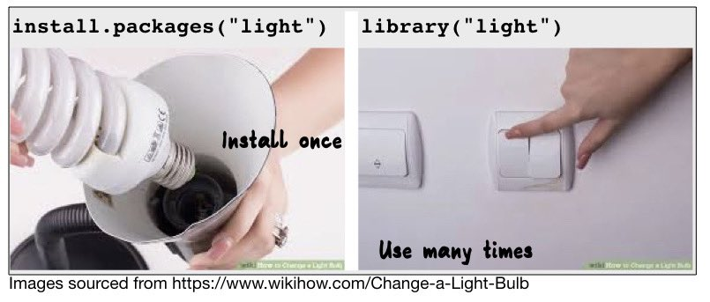
Using R packages
Open script7.R
install.packages(“package_name”)
Similar to going to a shop and buying cold medication of a particular brand
library(package_name)
Similar to using the cold medication you already have at home (because you bought it earlier)

Slide 154



Data Analysis Workflow
Input file(s)
Output file(s)
Raw Data File
raw_data.csv
Cleaned Data
clean_data.csv
plot1.png
Cleaning script
cleaning.R
Analysis script
analysis.R
table.csv
plot2.png
Code script(s)

Slide 155



Resources
Resource to continue learning R
https://bookdown.org/ndphillips/YaRrr/
See you tomorrow
at 9.30am sharp!

